Slide 1

OBJECT ORIENTED PROGRAMMING THROUGH C++
PROJECT REVIEW 2
STUDENT RECORD MANAGER USING C++
PRESENTED BY
M RAVITEJA (25B11AI281)
P JASWANTH KRISHNA (25B11AI992)
M S S V DURGA PRASAD (25B11AI729)
G SAI CHARAN (26B21AI043)
GUIDED BY
T VIJAYA LAKSHMI
Assistant Professor
Department of AIML
DEPARTMENT OF
ARTIFICIAL INTELLIGENCE AND MACHINE LEARNING

Slide 2



Contents
Abstract
Introduction
Problem Statement
Objectives
Modules and Functions
Implementation
C++ Concepts Used
Inputs
Expected Outputs
Flowchart
Team Contribution
Conclusion

Slide 3
Abstract
The Student Record Manager is a C++ application designed to store, manage, and analyze student records. It uses arrays to store student data and OOP concepts such as classes and objects to organize the records. The project includes features such as adding and displaying student details, searching for a student, finding the highest and lowest marks, calculating average marks, and handling student names using strings. It provides a simple and efficient way to manage student information while demonstrating the use of arrays, searching, string handling, and OOP concepts in C++.

Slide 4
Introduction
The Student Record Manager is a simple C++ project developed to store and manage student information efficiently. It uses arrays to store multiple student records and OOP concepts such as classes and objects to organize the data. The system allows users to add, display, and search student records, as well as analyze marks by finding the highest, lowest, and average marks. It also uses basic string handling for managing student names. This project demonstrates the practical use of arrays, searching, strings, and OOP concepts in C++.

Slide 5
Problem Statement
Managing student records manually can be time-consuming and difficult, especially when dealing with multiple students. Finding a particular student's details, analyzing marks, and identifying the highest or lowest marks can also require extra effort. The Student Record Manager aims to provide a simple C++-based solution to store, organize, search, and analyze student information using arrays, strings, searching techniques, and OOP concepts such as classes and objects.

Slide 6
Objectives
To store and manage student details using arrays.
To use classes and objects to organize student records.
To provide a simple method for adding, displaying, and searching student records
To analyze student marks and find the highest, lowest, and average marks.
To demonstrate string handling for student names.
To apply basic searching and data management techniques in C++.
To develop a simple and user-friendly student record management system.

Slide 7
Modules &Functions
Student Data Module – Stores student details such as roll number, name, and marks.
Add Student Module – Allows the user to enter and save new student records.
Display Module – Displays all stored student records.
Search Module – Searches for a student using their roll number.
Marks Analysis Module – Finds the highest, lowest, and average marks.
String Handling Module – Handles student names and other text data.
OOP Module – Uses classes and objects to organize student data and functions.
Menu Module – Provides options for the user to select different operations.

Slide 8
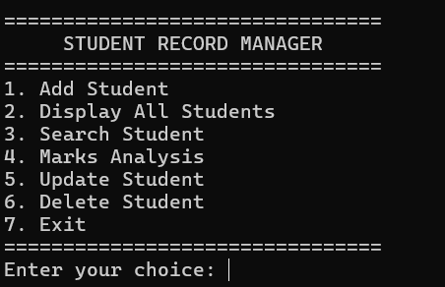
Implementation
Developed the project using C++.
Used classes and objects to represent student records.
Used an array of student objects to store multiple records.
Stored student details such as roll number, name, and marks.
Implemented a menu-driven system for different operations.
Added functionality to add and display student records.
Implemented linear search to find a student by roll number.
Applied basic OOP concepts to make the program organized and easy to maintain.

Slide 9
C++ Concepts Used
Classes and Objects
Arrays
Strings
Functions
Loops
Conditional Statements
Linear Searching
Encapsulation
Input/Output

Slide 10
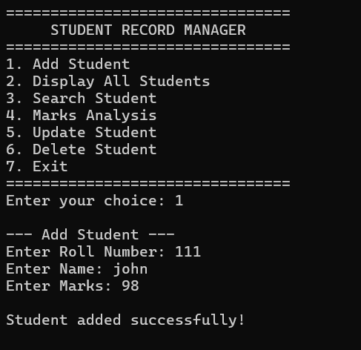
Inputs
Number of Students
Student Roll Number
Student Name
Student Marks
Search Roll Number
Search Student Name
Menu Choice
Subject Marks
Update Student Details
Delete Student Record
Continue/Exit Choice

Slide 11
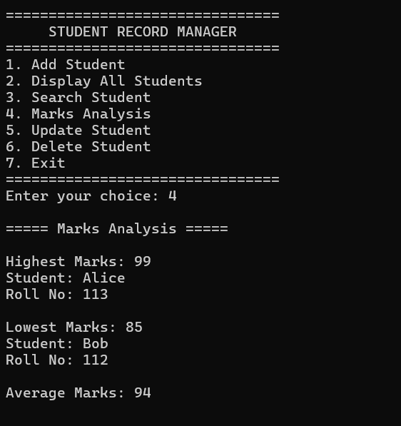
Expected Outputs
Display all student records
Display student details after searching
Display highest marks
Display lowest marks
Display average marks
Display student name and roll number
Display updated student records
Display deleted record confirmation
Display appropriate message when a student is not found
Display menu options and operation results

Slide 12
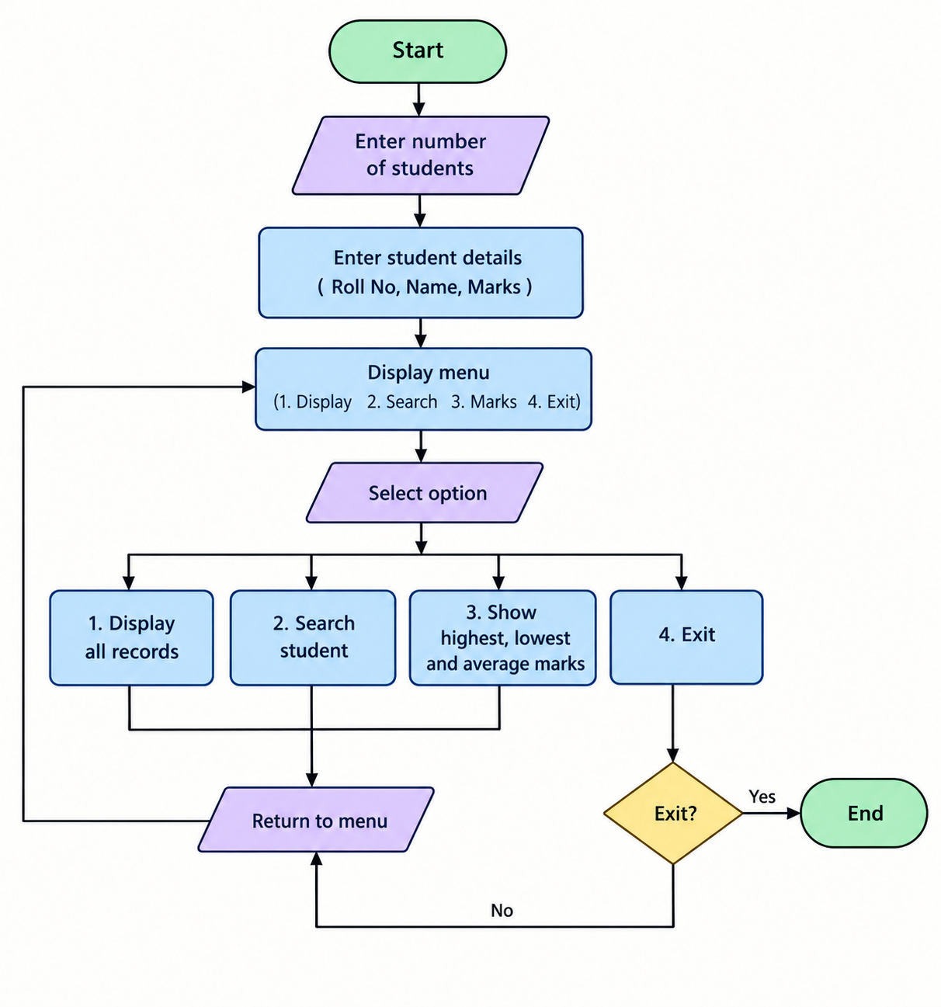
Flowchart

Slide 13
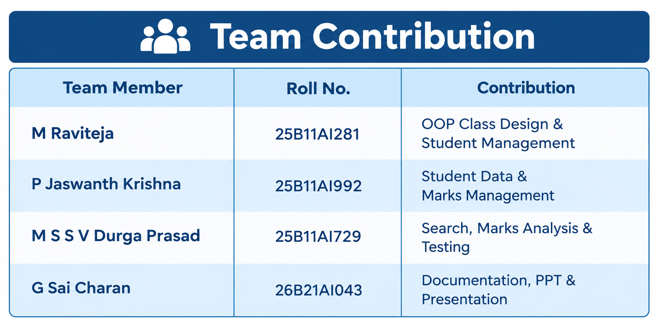

Slide 14
Conclusion
The Student Record Manager successfully provides a simple way to store, manage, search, and analyze student records. The project demonstrates the practical use of C++ concepts such as arrays, classes, objects, strings, functions, and searching. It helps in finding student details and analyzing marks such as highest, lowest, and average marks. Overall, the project improves our understanding of C++ programming and basic data management.

Slide 15
Thank You

